Slide 1
Disbursal Flow (ID: 12a396c030e)
IPRU Payout
https://hk001.blueworkslive.com/scr/processes/12a396c030e
Created on Mar 29, 2018 10:55 AM by Swapnil Kothawade (swapnil.kothawade@dhdigital.co.in) Last modified on Apr 26, 2018 6:28 PM by Swapnil Kothawade (swapnil.kothawade@dhdigital.co.in)

Slide 2
Disbursal Flow
Spool Inward
Funding
Holding
Exception Check
Manual Exception Check
Sampling
Get Data From ADW
Send Mail to Investment Team
Hold and Release Cases
Exception Check
Manual Exception Check
Auto Sampling
DMS Base Upload
Continue for Disbursal
Exception Confirmation
Sampling Split Screen
Send Mail to Process Owner
Inform amount is available
Add Claims Funding Amount and Disbursal Amount
Enter Claims Funding Amount
send mail to Process Owner

Slide 3
Disbursal Flow
PRN Reversal
PRN Reversal Bucket
Disbursal
Reverse PRN
Send Communication To customer
Get Seq No for Each PRN
DMS Upload for Reverse
Send in PRN Reversal Bucket
Consider PayDate
consider Auth Date
PDF File Generation for Cheque
File Generation for Bank Site Upload
Encrypt File using AES
DMS Upload for Disbursal
Call Closure In SPAARC

Slide 4
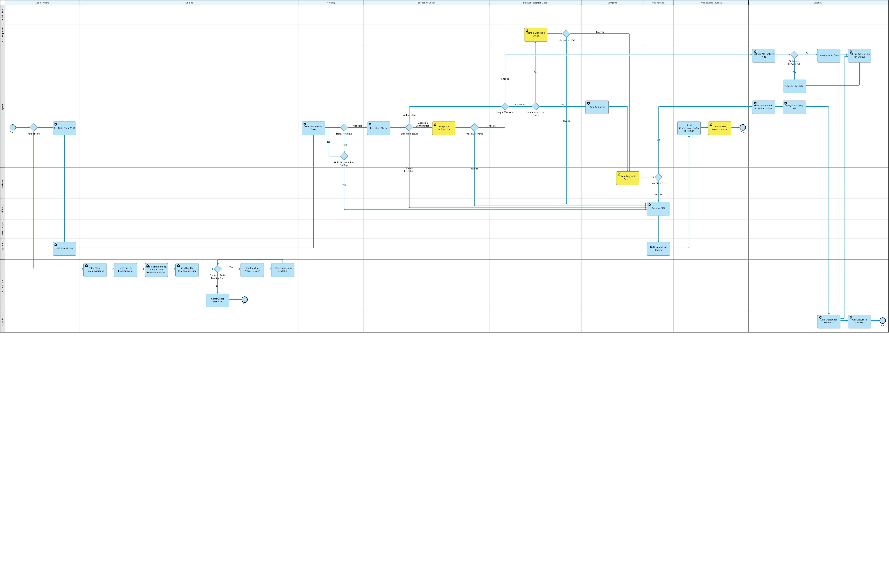
Disbursal Flow

Slide 5
Appendix

Slide 6
1.2. Spool Inward > Get Data From ADW
Description
System
-ADW Team to push the data into Cordys DB in the table name- Disbursal_spool_new.
-Time and Number of spools at which data will be pushed in Cordys?
Participants
No inputs identified for this activity
Inputs
No outputs identified for this activity
Outputs
No problems identified for this activity
Problems

Slide 7
1.3. Spool Inward > DMS Base Upload
Description
DMS System
Participants
No inputs identified for this activity
Inputs
No outputs identified for this activity
Outputs
No problems identified for this activity
Problems

Slide 8
2.1. Funding > Enter Claims Funding Amount
Description
Claims Team
There will be a separate role and access given to Claims team to enter the total amount to send it to investment team with addition of disbursal amount.
Claims amount + Disbursal amount will be sent to investment team for funding.
Participants
No inputs identified for this activity
Inputs
No outputs identified for this activity
Outputs
No problems identified for this activity
Problems

Slide 9
2.2. Funding > send mail to Process Owner
Description
Claims Team
Participants
No inputs identified for this activity
Inputs
No outputs identified for this activity
Outputs
No problems identified for this activity
Problems

Slide 10
2.3. Funding > Add Claims Funding Amount and Disbursal Amount
Description
Claims Team
A user interface will be provided where disbursal amount and claims amount will be entered.
Participants
No inputs identified for this activity
Inputs
No outputs identified for this activity
Outputs
No problems identified for this activity
Problems

Slide 11
2.4. Funding > Send Mail to Investment Team
Description
Claims Team
After the entry of both the amounts, there will be a mail triggered to the investment team with the total amount for funding.
Disbursal amount + Claims amount = Funding amount.
Participants
No inputs identified for this activity
Inputs
No outputs identified for this activity
Outputs
No problems identified for this activity
Problems

Slide 12
2.5. Funding > Disbursal Amt> Funding Amt
Description
If disbursal amount > funding amount ,
then
send mail to process owner.
else
Continue for Disbursal.
No inputs identified for this activity
Inputs
No outputs identified for this activity
Outputs
No problems identified for this activity
Problems

Slide 13
2.6. Funding > Send Mail to Process Owner
Description
Claims Team
Participants
No inputs identified for this activity
Inputs
No outputs identified for this activity
Outputs
No problems identified for this activity
Problems

Slide 14
2.7. Funding > Inform amount is available
Description
Claims Team
Participants
No inputs identified for this activity
Inputs
No outputs identified for this activity
Outputs
No problems identified for this activity
Problems

Slide 15
2.8. Funding > Continue for Disbursal
Description
Claims Team
Participants
No inputs identified for this activity
Inputs
No outputs identified for this activity
Outputs
No problems identified for this activity
Problems

Slide 16
3.1. Holding > Hold and Release Cases
Description
System
Participants
No inputs identified for this activity
Inputs
No outputs identified for this activity
Outputs
No problems identified for this activity
Problems

Slide 17
4.1. Exception Check > Exception Check
Description
System
Participants
No inputs identified for this activity
Inputs
No outputs identified for this activity
Outputs
No problems identified for this activity
Problems

Slide 18
4.3. Exception Check > Exception Confirmation
Description
System
Participants
No inputs identified for this activity
Inputs
No outputs identified for this activity
Outputs
No problems identified for this activity
Problems

Slide 19
5.3. Manual Exception Check > Manual Exception Check
Description
IPRU Employee
Participants
No inputs identified for this activity
Inputs
No outputs identified for this activity
Outputs
No problems identified for this activity
Problems

Slide 20
6.1. Sampling > Auto Sampling
Description
System
Participants
No inputs identified for this activity
Inputs
No outputs identified for this activity
Outputs
No problems identified for this activity
Problems

Slide 21
6.2. Sampling > Sampling Split Screen
Description
Reviewer 1
Participants
No inputs identified for this activity
Inputs
No outputs identified for this activity
Outputs
No problems identified for this activity
Problems

Slide 22
7.2. PRN Reversal > Reverse PRN
Description
Life Asia
Participants
No inputs identified for this activity
Inputs
No outputs identified for this activity
Outputs
No problems identified for this activity
Problems

Slide 23
7.3. PRN Reversal > DMS Upload for Reverse
Description
DMS System
Participants
No inputs identified for this activity
Inputs
No outputs identified for this activity
Outputs
No problems identified for this activity
Problems

Slide 24
8.1. PRN Reversal Bucket > Send Communication To customer
Description
System
Participants
No inputs identified for this activity
Inputs
No outputs identified for this activity
Outputs
No problems identified for this activity
Problems

Slide 25
8.2. PRN Reversal Bucket > Send in PRN Reversal Bucket
Description
System
Participants
No inputs identified for this activity
Inputs
No outputs identified for this activity
Outputs
No problems identified for this activity
Problems

Slide 26
9.1. Disbursal > File Generation for Bank Site Upload
Description
System
Participants
No inputs identified for this activity
Inputs
No outputs identified for this activity
Outputs
No problems identified for this activity
Problems

Slide 27
9.2. Disbursal > Encrypt File using AES
Description
System
Participants
No inputs identified for this activity
Inputs
No outputs identified for this activity
Outputs
No problems identified for this activity
Problems

Slide 28
9.3. Disbursal > DMS Upload for Disbursal
Description
SPAARC
Participants
No inputs identified for this activity
Inputs
No outputs identified for this activity
Outputs
No problems identified for this activity
Problems

Slide 29
9.4. Disbursal > Call Closure In SPAARC
Description
SPAARC
Participants
No inputs identified for this activity
Inputs
No outputs identified for this activity
Outputs
No problems identified for this activity
Problems

Slide 30
9.5. Disbursal > Get Seq No for Each PRN
Description
System
Participants
No inputs identified for this activity
Inputs
No outputs identified for this activity
Outputs
No problems identified for this activity
Problems

Slide 31
9.7. Disbursal > consider Auth Date
Description
System
Participants
No inputs identified for this activity
Inputs
No outputs identified for this activity
Outputs
No problems identified for this activity
Problems

Slide 32
9.8. Disbursal > PDF File Generation for Cheque
Description
System
Participants
No inputs identified for this activity
Inputs
No outputs identified for this activity
Outputs
No problems identified for this activity
Problems

Slide 33
9.9. Disbursal > Consider PayDate
Description
System
Participants
No inputs identified for this activity
Inputs
No outputs identified for this activity
Outputs
No problems identified for this activity
Problems

